Slide 1




NLP tasks in GIS and information extraction from text
prof. dr Ranka Stanković, ranka@rgf.rs University of Belgrade, Faculty of Mining and Geology JeRTeh (Language Resources and Technologies Society)
PhD winter class : Big data and artificial intelligence supporting climate and water science
Earth and Life Institute of UCLouvain, Louvain-la-Neuve, 27.1.2025. 9h-10:30h
https://sites.google.com/view/envitam/upcoming-events/big-data-and-water-management

Slide 2
Motivation
NLP tasks in GIS
advancement in the interaction and analysis of geospatial data through text-based input.
By facilitating the interpretation of natural language queries
NLP enhances the accessibility and usability of GIS for a broader audience
NLP allows users to retrieve relevant spatial information with minimal technical expertise.
This integration transforms traditional GIS applications,
enabling sophisticated analysis of vast amounts of textual data from various sources (social media, reports, and emergency notifications),
improving decision-making processes in critical areas such as disaster management and urban planning.

Slide 3
Outline
Why Combine NLP and GIS?
NLP tasks introduction
Tools and libraries
Case study
in English
in Serbian
Practical parts
Interactive tools
Python notebooks
QGIS

Slide 4
Why Combine NLP and GIS?
Extract Geographic Information from Text
Many datasets, reports, or social media posts contain locations in unstructured text.
NLP can identify and classify place names (toponyms), addresses, or coordinates, which GIS can then map.
Enrich Geospatial Data
By extracting keywords, topics, or sentiments related to geographic locations, you can create thematic maps or conduct spatial analyses that incorporate text-derived attributes.
Disambiguation and Geocoding
“Paris” might refer to Paris, France, or Paris, Texas. NLP + GIS can help disambiguate and link these place mentions to correct coordinates.
Spatial-Temporal Analysis
When text includes timestamps and location references, you can do spatio-temporal analytics (e.g. event detection over time and space).

Slide 5
NLP Tasks in GIS: more intuitive interaction with geospatial data
The integration of NLP into GIS
enhances the ability to analyze, extract, and visualize information.
Enhancing User Interactions
NLP allows users to interact with GIS tools using natural language queries, significantly lowering the barriers for non-experts:
“Show me areas with high flood risk in California!” , the system can interpret the query to display relevant spatial data
"Show the population density of New York City," allowing them to engage with GIS tools more intuitively
This capability is achieved through sophisticated NLP algorithms
that process user input,
identify relevant place names, and
execute geospatial searches accordingly
see Geospatial Query System with NLP and GIS Integration https://github.com/gr2100/Geospatial-Query-System-with-NLP-and-GIS-Integration

Slide 6
Text Classification and Information Extraction
Text classification assigns predefined categories to text data.
models based on the Transformer architecture can classify text effectively, giving meaningful insights from large datasets
incident reports can be categorized by crime type, allowing urban planners to plan interventions
see “How Text Classification works” https://pro.arcgis.com/en/pro-app/latest/tool-reference/geoai/how-text-classification-works.htm
geolocated tweets can be analyzed for sentiment regarding public health initiatives, facilitating targeted outreach
see “7 NLP Techniques for Extracting Information from Unstructured Text using Algorithms” https://www.width.ai/post/extracting-information-from-unstructured-text-using-algorithms
Information extraction (IE) from text is a fundamental task in NLP
automatical converzion of unstructured textual data into a structured format that can be analyzed and utilized for various applications.
IE subtasks:
identifying and extracting specific types of information such as entities
see “The Complete Guide to Information Extraction from Texts with Spark NLP and Python” https://www.johnsnowlabs.com/the-complete-guide-to-information-extraction-from-texts-with-spark-nlp-and-python/
relationships between entities, and
events occurring within the text

Slide 7
Applications
Applications in Disaster Management
by facilitating real-time access to critical information through natural language queries, GIS can provide timely data for emergency responders and decision-makers.
ability to interpret and analyze textual data during crises (social media/emergency notifications), can improve response efforts and resource allocation
enabling agencies to prepare for and respond to natural disasters effectively, in mapping hazard zones, assessing vulnerability, and planning evacuation routes
by analyzing spatial data, emergency responders can allocate resources more efficiently and make informed decisions during crises, ultimately saving lives and minimizing damage.
Code Generation for Analysis
The integration of NLP with Generative AI allows for the automatic generation of executable codes for complex geospatial analyses. By translating natural language requests into code, these systems enable non-expert users to perform sophisticated analyses without needing extensive knowledge of GIS
see Title: “ChatGeoAI: Enabling Geospatial Analysis for Public through Natural Language, with Large Language Models” https://www.mdpi.com/2220-9964/13/10/348
This automation significantly enhances efficiency and encourages broader adoption of GIS technologies across various fields.

Slide 8
Information Extraction from Text
Named Entity Recognition (NER) & Linking (NEL)
identify and categorize entities such as locations, organizations, events and dates within text
NER models typically utilize machine learning algorithms to tag words or phrases with their corresponding entity types
coupled with fuzzy matching, enhances the system's ability to handle variations in spelling and phrasing to improve the accuracy of geospatial queries [gr2010]
synonyms matching or old names of places nad streets
integration of these techniques ensures that GIS can efficiently process and visualize information, even when the input data is unstructured or imprecise.
Relation Extraction
identify and extract relationships between entities mentioned in the text.
For instance, it can extract the relationship indicating that a specific individual "is the CEO of" a certain organization
see https://geo-nexus.com/solve-3-common-gis-integration-challenges-with-these-proven-approaches/
Event Extraction
involves identifying specific events or actions described in text, determining the event triggers (the words or phrases representing the event) and the arguments (the entities involved in the event)
Optionaly, dependency parsing
analyzes the grammatical structure of sentences to understand relationships between words and entities in text.

Slide 9
Practical Applications of IE
Information Retrieval
Enhancing search by extracting structured information from unstructured text
Knowledge Graph Construction
Support Building by extracting entities and their interrelationships from textual data
Sentiment Analysis
Identifying and extracting opinions and sentiments expressed in text, which can inform decision-making processes in various domains
Event Monitoring
Tracking and summarizing developments from news articles or social media, providing timely insights into current events (or in disaster scenario)

Slide 10
Tools, Libraries and Techniques NLP ~ GIS
NLTK, spaCy, Stanford NER, … simplify the implementation of NLP
NLTK (Natural Language Toolkit): One of the oldest, widely used libraries for NLP, comprehensive set of tools (not optimal for production systems) https://www.nltk.org/
SpaCy is a state-of-the-art NLP library that is built for the fast implementation and use of natural language processing tasks (will be used in use cas). https://spacy.io/
TextBlob: A user-friendly library built on NLTK, with sentiment analysis and text classification
State-of-the-art language models (BERT, RoBERTa, GPT, etc.)., advanced NLP, https://github.com/huggingface/transformers
Stanford CoreNLP: powerful toolset developed by Stanford University: parsing, sentiment analysis, and NER, supporting multiple languages, Java-based, can be used via REST APIs or Python wrappers.
machine learning frameworks like scikit-learn and TensorFlow can be used to train custom models for specific extraction tasks

Slide 11
Technical Challenges in Integrating NLP with GIS
Data Quality and Integrity
vast amounts of spatial data collected from various sources, when combined with NLP-generated data risk inconsistencies increases
it is crucial to utilize high-quality and up-to-date data sources to minimize inaccuracies that can arise from NLP interpretations.
see “How To Implement Information Extraction Systems Made Simple” https://spotintelligence.com/2023/10/10/information-extraction/
Complex Command Interpretation
While NLP aims to simplify user interactions with GIS, the complexity of natural language itself poses significant challenges.
NLP algorithms must accurately interpret user queries that may be ambiguous or context-dependent.
Ex. "Show me flood risk areas" could yield different results based on regional definitions or the type of flood data available.
Advanced AI algorithms are necessary to understand the context and semantics of such queries effectively.
see “Boost GIS Efficiency with AI: Top Libraries & Tools” https://aicompetence.org/boost-gis-efficiency-with-ai-top-libraries-tools/
Scalability Issues
As GIS projects grow in scope and complexity, scaling NLP capabilities becomes a challenge.
Handling large volumes of text data from diverse sources, requires robust processing power and sophisticated NLP techniques.
If the system cannot efficiently scale, it may lead to bottlenecks in data processing and analysis, limiting the effectiveness of GIS applications in real-time scenarios like disaster management.
see “GIS Applications: Real-World Use Cases & Examples” https://id.land/blog/gis-applications-real-world-use-cases-examples
Integration with Legacy Systems
Integrating NLP functionalities with existing legacy GIS systems can also pose significant technical hurdles.
Traditional GIS applications may not be designed to support modern NLP tools, leading to compatibility issues.
Developing custom integrations often requires specialized skills and can be time-consuming, hindering an organization's ability to adapt quickly to evolving business needs.
Solutions like Geonexus Integration Platform provida out-of-the-box tools that facilitate data integration between GIS and enterprise systems, bu legacy constraints remains a key challenge.
see: “What kinds of problems can GIS help solve? - Geographic Pedia - NCESC” https://www.ncesc.com/geographic-pedia/what-kinds-of-problems-can-gis-help-solve/
User Interface Design
user-friendly interfaces 4 interaction between NLP and GIS
NLP enhances accessibility, but it must be intuitive for users who may not have technical expertise: balancing the complexity of underlying algorithms with the need for simplicity in user interactions.

Slide 12
Tools and Libraries for NLP in GIS
One practical application of NLP in QGIS involves sentiment analysis of public discourse regarding climate change.
By processing social media posts and news articles, NLP algorithms can gauge public sentiment and engagement on climate issues.
This information can be visualized in QGIS to identify regions with varying levels of public concern, which can help inform targeted outreach and policy efforts [11] [10]
Nlp For Climate Data Analysis - Restackio https://www.restack.io/p/ai-for-climate-change-answer-nlp-climate-data-analysis-cat-ai
Applying NLP in Climate Change Analysis – Veritas NLP, https://veritasnlp.com/applying-nlp-in-climate-change-analysis/

Slide 13
Geocoding / Geoparsing Tools
GeoText https://pypi.org/project/geotext/
Simple Python library to extract city and country mentions from text.
geograpy3 https://pypi.org/project/geograpy3/
Extract place names from URL or text, then resolve them using the Geonames database.
Has basic functionality for toponym resolution.
CLAVIN https://github.com/camechis/CLAVIN
Cartographic Location And Vicinity INdexer,Java-based open-source software for geoparsing text (toponym recognition) and resolving location names against gazetteers like Geonames.
GeoPandas: https://geopandas.org/
geopy: https://github.com/geopy/geopy
ArcGIS Geocoding APIs / ArcGIS API for Python
in Esri environment, geocode addresses or place names directly.https://developers.arcgis.com/python/latest/api-reference/arcgis.geocoding.html

Slide 14
Proceedings of the 1st Workshop on Natural Language Processing Meets Climate Change (ClimateNLP 2024)
Utilizing NLP to track the coherence of Climate Policy Documents in the Context of the Paris Agreement
Informing climate risk analysis using textual information
An Application of NLP in Climate Adaptation for Agriculture
Generative Debunking of Climate Misinformation
Decoding Climate Disagreement: A Graph NN-Based Approach to Understanding Social Media Dynamics
Evaluating ChatNetZero: LLM-Chatbot to Demystify Climate Pledges
Envisioning NLP for intercultural climate communication
Large Scale Narrative Messaging around Climate Change
Structuring Sustainability Reports for Environmental Standards with LLMs guided by Ontology
Unlearning Climate Misinformation in LLMs
Evaluating Entity Linking on Climate Change Data
Aligning Unstructured Paris Agreement Climate Plans with Sustainable Development Goals
Granular Analysis of Social Media Users’ Truthfulness Stances Toward Climate Change Factual Claims
Assessing the Effectiveness of GPT-4o in Climate Change Evidence Synthesis and Systematic Assessments
https://aclanthology.org/volumes/2024.climatenlp-1/

Slide 15
GIS Libraries / Tools
GeoPandas
Extends Pandas to handle geospatial data (GeoDataFrame).
Integrates well with shapely for geometry manipulation and matplotlib/folium for mapping.
Shapely
Library for geometric operations (buffering, intersection, etc.).
Folium or kepler.gl for Jupyter
Interactive map visualization in a Jupyter notebook.
QGIS
Full-featured open-source desktop GIS.
Can integrate Python (PyQGIS) for custom geospatial scripting.

Slide 16
Additional Considerations
Entity Disambiguation:
“Paris” could be many different places. Tools like geograpy, geotext, or CLAVIN attempt to disambiguate by textual context. Or you can store multiple results and let a user choose the correct one.
Gazetteers and External Services:
For best results, a high-quality gazetteer (like Geonames, OSM’s Nominatim, or your own curated list) is crucial.
Some enterprise environments might use an ArcGIS geocoding service or an internal address locator.
Handling Large-Scale Data:
If you have massive text corpora, consider distributed computing (Spark NLP, etc.) and a spatially-enabled database (like PostGIS) to manage resulting coordinates.
Custom NLP Models:
For specialized domains (historical texts, specific industries, local dialects), training a custom NER model might give better performance than out-of-the-box models.
Data Privacy and Licensing:
Geocoding APIs often have usage limits or license constraints.
Sensitive data (e.g., addresses) might need anonymization or special handling.

Slide 17
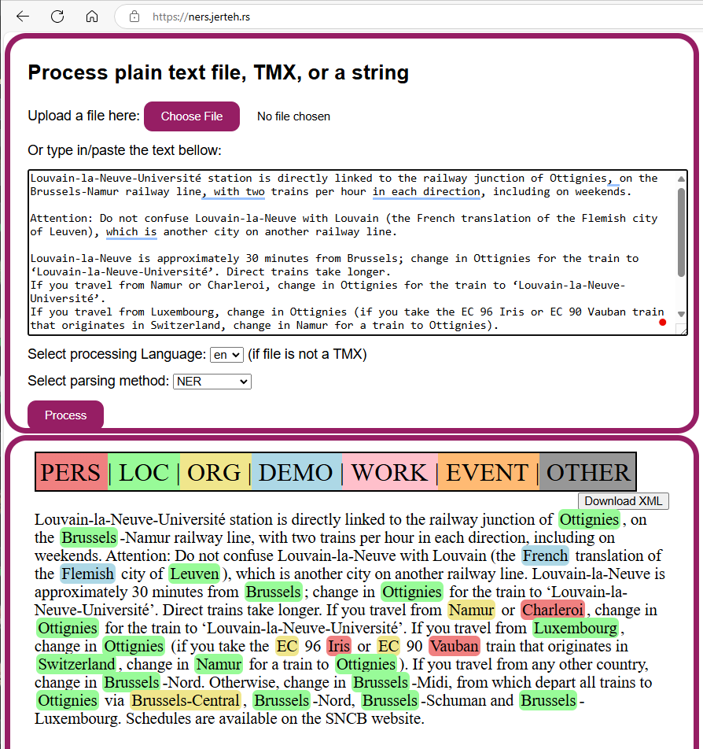
NER
Louvain-la-Neuve-Université station is directly linked to the railway junction of Ottignies, on the Brussels-Namur railway line, with two trains per hour in each direction, including on weekends.
Attention: Do not confuse Louvain-la-Neuve with Louvain (the French translation of the Flemish city of Leuven), which is another city on another railway line. Louvain-la-Neuve is approximately 30 minutes from Brussels; change in Ottignies for the train to ‘Louvain-la-Neuve-Université’. Direct trains take longer.
If you travel from Namur or Charleroi, change in Ottignies for the train to ‘Louvain-la-Neuve-Université’.
If you travel from Luxembourg, change in Ottignies (if you take the EC 96 Iris or EC 90 Vauban train that originates in Switzerland, change in Namur for a train to Ottignies).
If you travel from any other country, change in Brussels-Nord. Otherwise, change in Brussels-Midi, from which depart all trains to Ottignies via Brussels-Central, Brussels-Nord, Brussels-Schuman and Brussels-Luxembourg.
Schedules are available on the SNCB website.
https://ners.jerteh.rs/

Slide 18
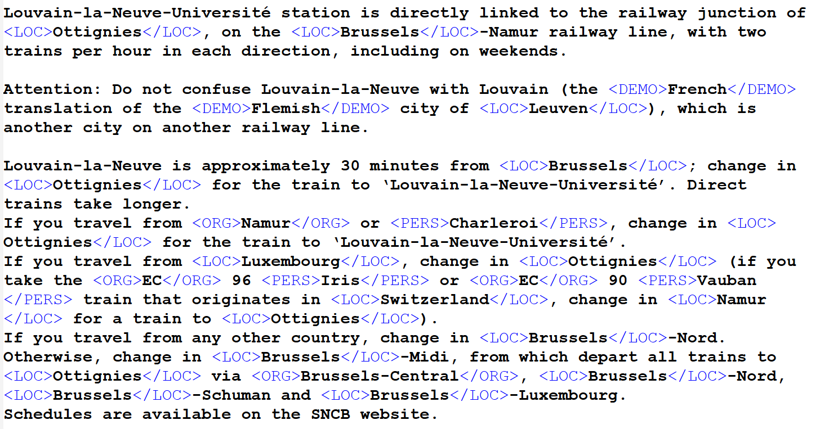
Internal representation

Slide 19
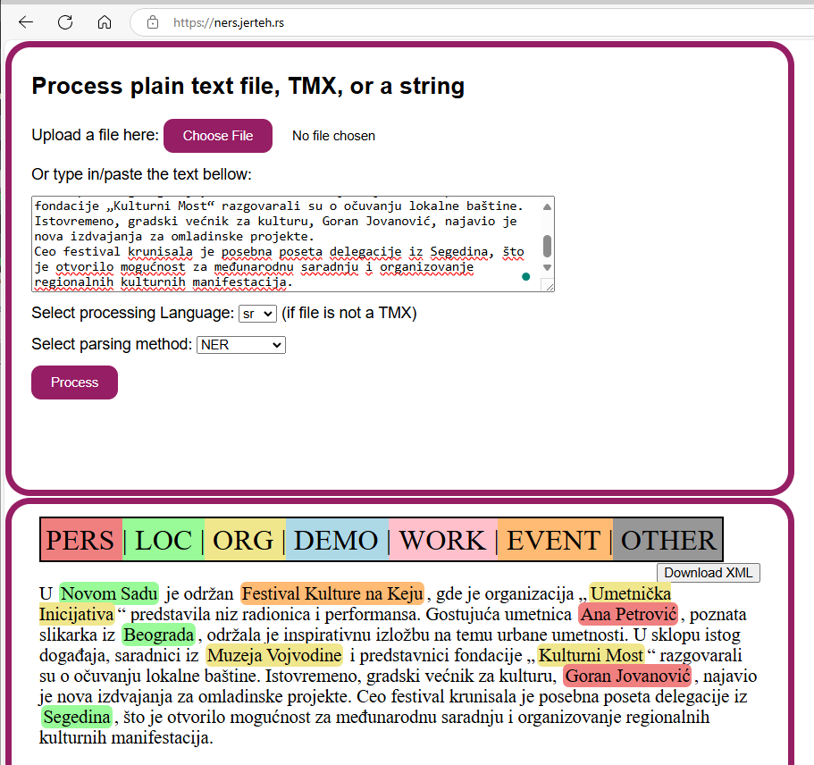
NER
U Novom Sadu je održan Festival Kulture na Keju, gde je organizacija „Umetnička Inicijativa“ predstavila niz radionica i performansa.
Gostujuća umetnica Ana Petrović, poznata slikarka iz Beograda, održala je inspirativnu izložbu na temu urbane umetnosti.
U sklopu istog događaja, saradnici iz Muzeja Vojvodine i predstavnici fondacije „Kulturni Most“ razgovarali su o očuvanju lokalne baštine.
Istovremeno, gradski većnik za kulturu, Goran Jovanović, najavio je nova izdvajanja za omladinske projekte.
Ceo festival krunisala je posebna poseta delegacije iz Segedina, što je otvorilo mogućnost za međunarodnu saradnju i organizovanje regionalnih kulturnih manifestacija.
https://ners.jerteh.rs/

Slide 20
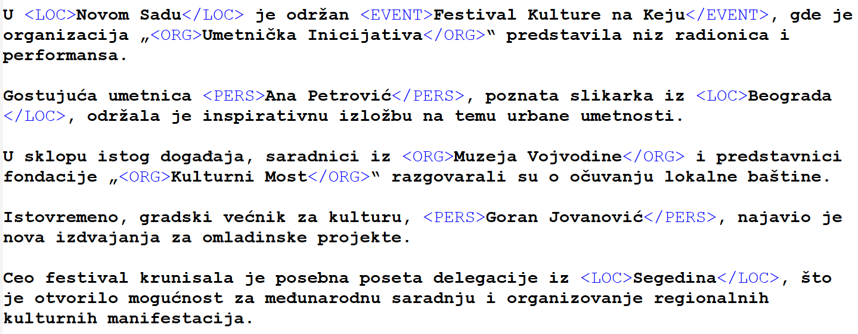
NER: internal representation

Slide 21
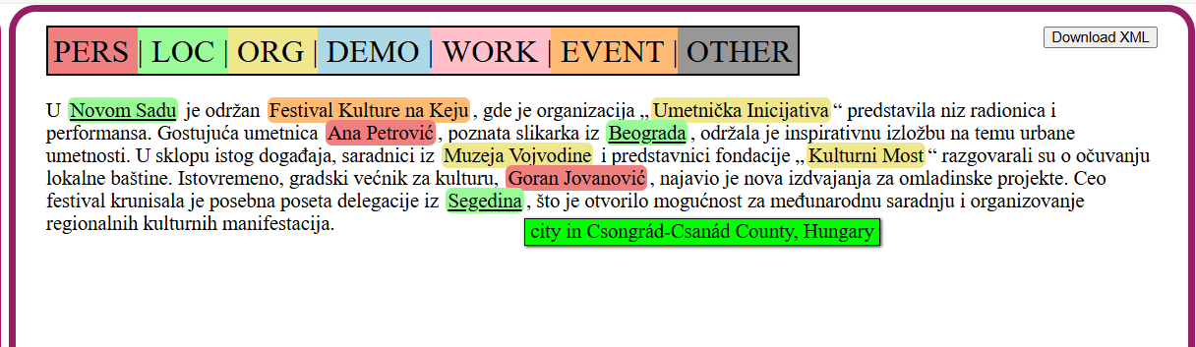
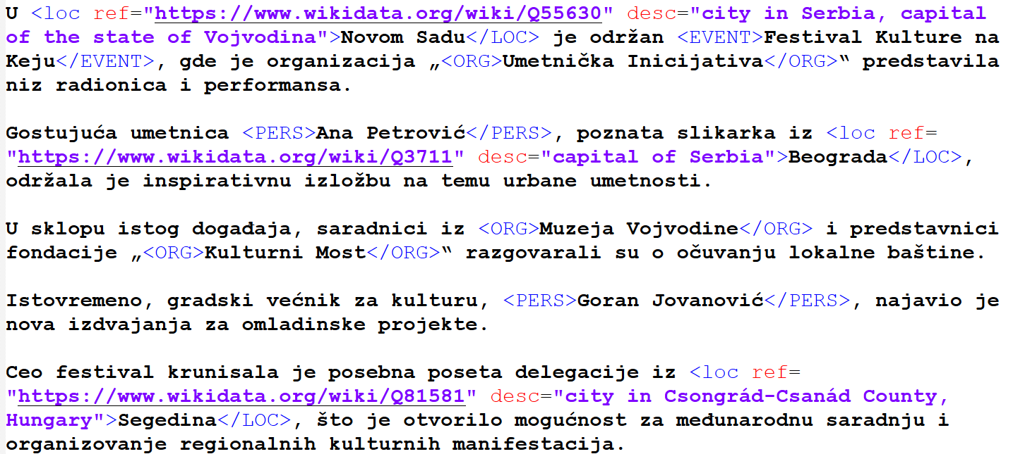
NER+NEL
https://ners.jerteh.rs/

Slide 22
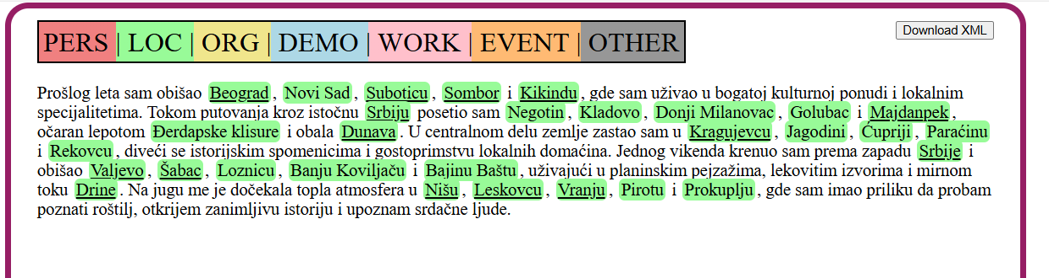
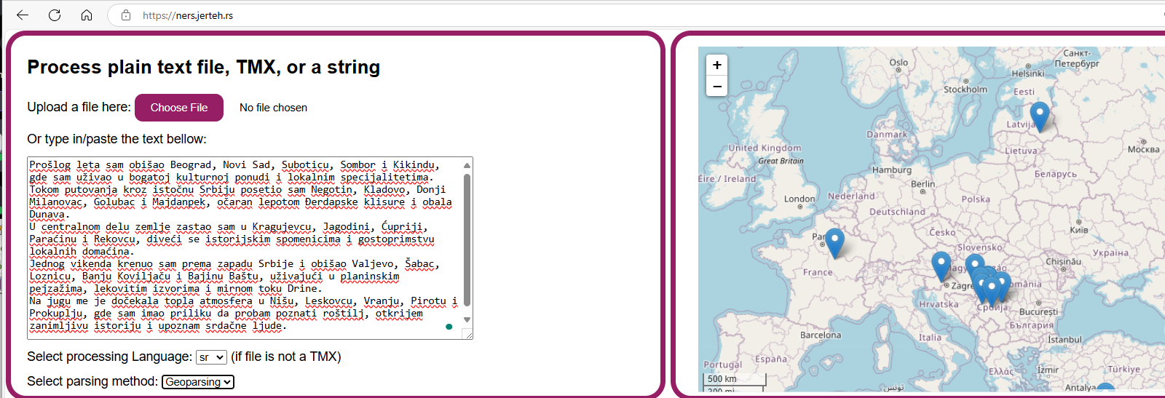
NERs (geolocations)
Problems:
Drine (France instead of BiH)
Danube
https://ners.jerteh.rs/
Notes:
Prošlog leta sam obišao Beograd, Novi Sad, Suboticu, Sombor i Kikindu, gde sam uživao u bogatoj kulturnoj ponudi i lokalnim specijalitetima.
Tokom putovanja kroz istočnu Srbiju posetio sam Negotin, Kladovo, Donji Milanovac, Golubac i Majdanpek, očaran lepotom Đerdapske klisure i obala Dunava.
U centralnom delu zemlje zastao sam u Kragujevcu, Jagodini, Ćupriji, Paraćinu i Rekovcu, diveći se istorijskim spomenicima i gostoprimstvu lokalnih domaćina.
Jednog vikenda krenuo sam prema zapadu Srbije i obišao Valjevo, Šabac, Loznicu, Banju Koviljaču i Bajinu Baštu, uživajući u planinskim pejzažima, lekovitim izvorima i mirnom toku Drine.
Na jugu me je dočekala topla atmosfera u Nišu, Leskovcu, Vranju, Pirotu i Prokuplju, gde sam imao priliku da probam poznati roštilj, otkrijem zanimljivu istoriju i upoznam srdačne ljude.

Slide 23
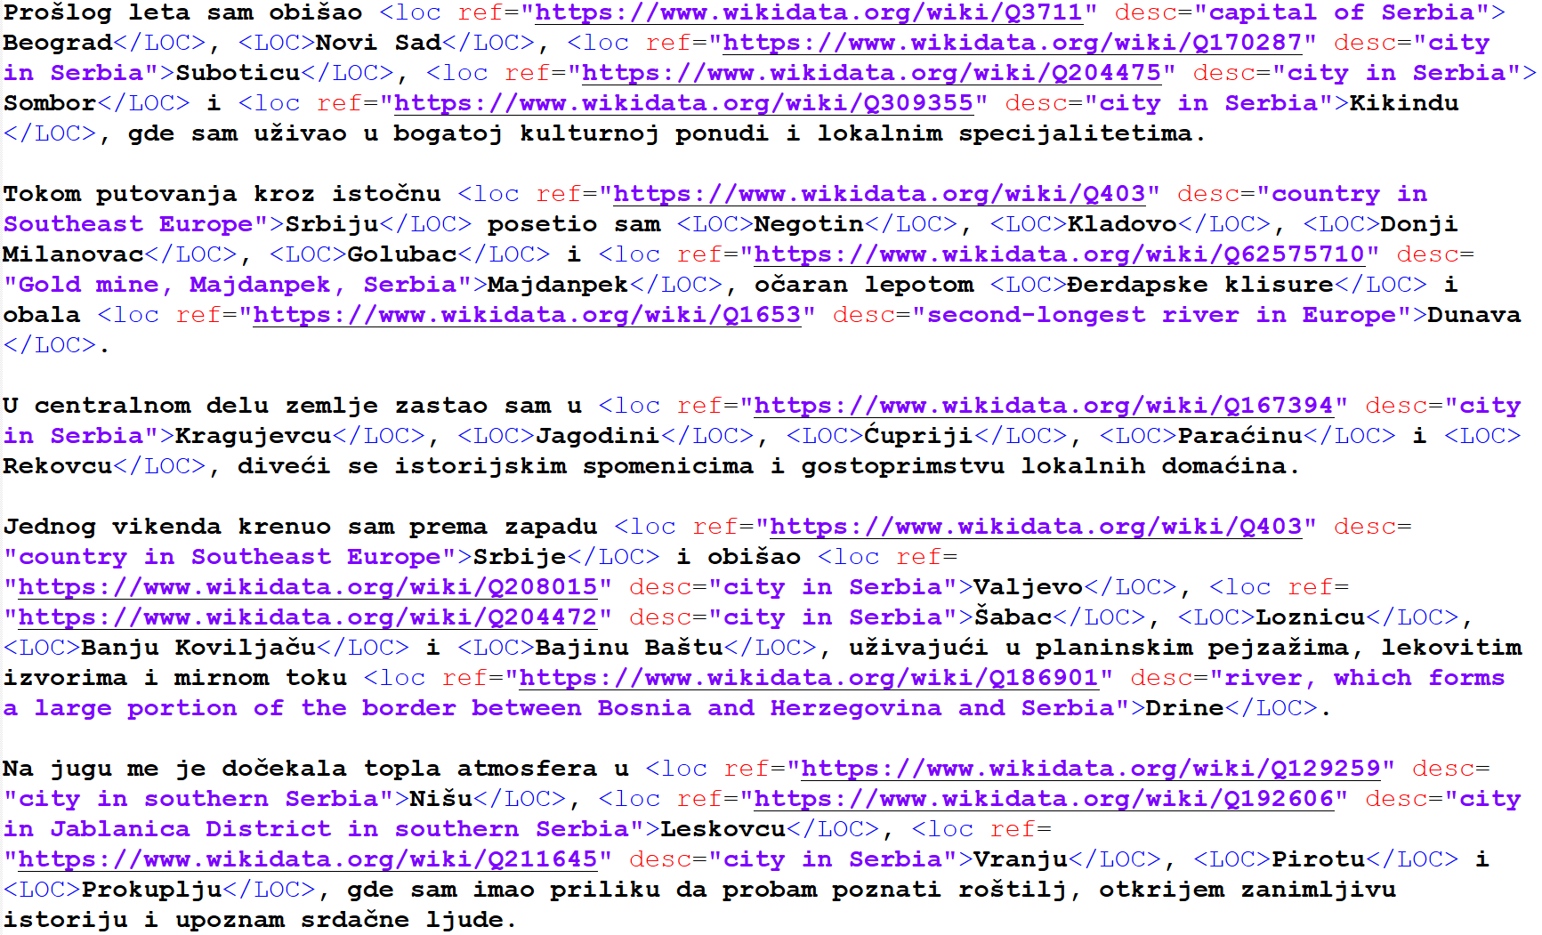
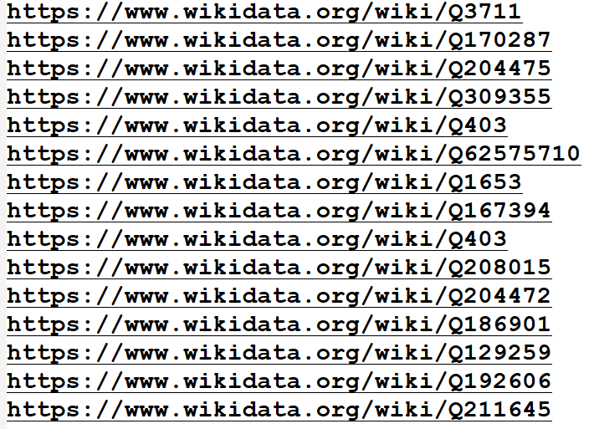
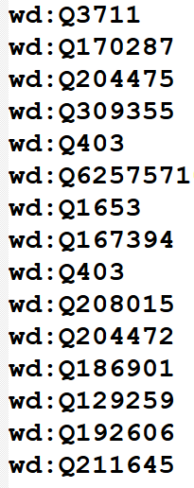

Slide 24
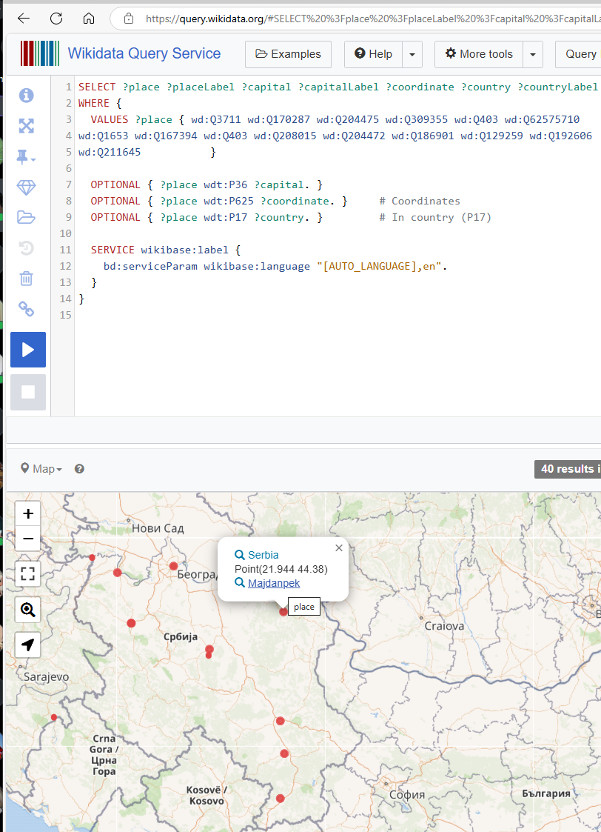
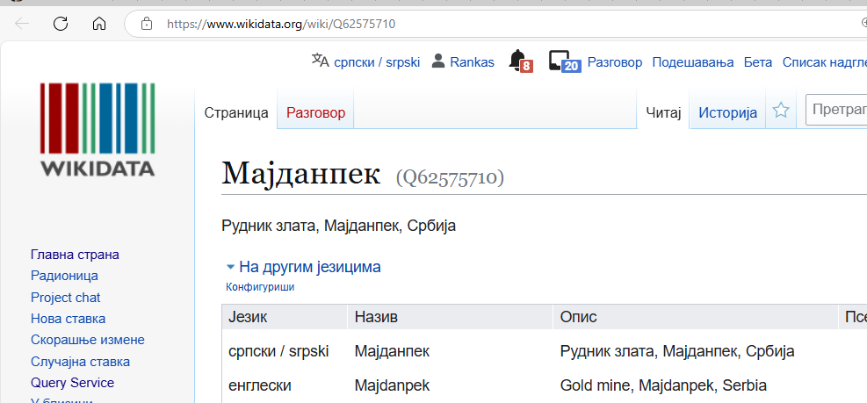
SPARQL
SELECT ?place ?placeLabel ?capital ?capitalLabel ?coordinate ?country ?countryLabel
WHERE {
VALUES ?place { wd:Q3711 wd:Q170287 wd:Q204475 wd:Q309355 wd:Q403 wd:Q62575710 wd:Q1653 wd:Q167394 wd:Q403 wd:Q208015 wd:Q204472 wd:Q186901 wd:Q129259 wd:Q192606 wd:Q211645 }
OPTIONAL { ?place wdt:P36 ?capital. }
OPTIONAL { ?place wdt:P625 ?coordinate. } # Coordinates
OPTIONAL { ?place wdt:P17 ?country. } # In country (P17)
SERVICE wikibase:label {
bd:serviceParam wikibase:language "[AUTO_LANGUAGE],en".
}
}
https://w.wiki/CqWJ

Slide 25
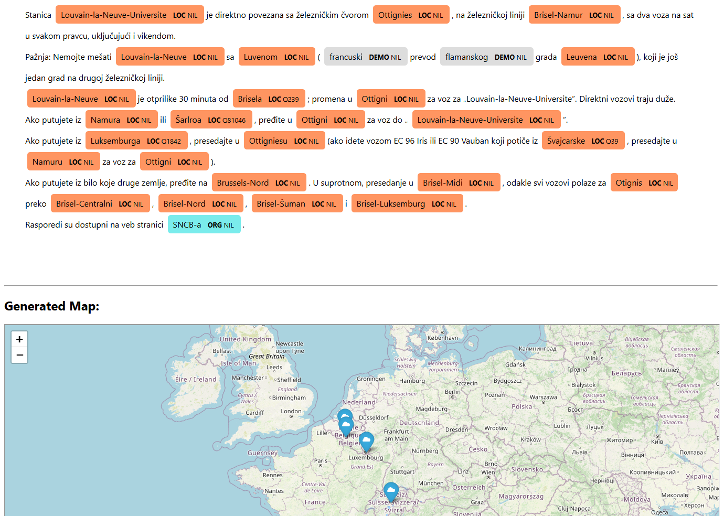
Entity Mapping Application (for text in Serbian)
Stanica Louvain-la-Neuve-Universite je direktno povezana sa železničkim čvorom Ottignies, na železničkoj liniji Brisel-Namur, sa dva voza na sat u svakom pravcu, uključujući i vikendom. Nemojte mešati Louvain-la-Neuve sa Luvenom (francuski prevod flamanskog grada Leuvena), koji je još jedan grad na drugoj železničkoj liniji. Louvain-la-Neuve je otprilike 30 minuta od Brisela; promena u Ottigni za voz za „Louvain-la-Neuve-Universite”. Ako putujete iz Namura ili Šarlroa, pređite u Ottigni za voz do „Louvain-la-Neuve-Universite“. Ako putujete iz Luksemburga, presedajte u Ottigniesu (ako idete vozom EC 96 Iris ili EC 90 Vauban koji potiče iz Švajcarske, presedajte u Namuru za voz za Ottigni). Ako putujete iz bilo koje druge zemlje, pređite na Brussels-Nord. U suprotnom, presedanje u Brisel-Midi, odakle svi vozovi polaze za Otignis preko Brisel-Centralni, Brisel-Nord, Brisel-Šuman i Brisel-Luksemburg. Rasporedi su dostupni na veb stranici SNCB-a.
https://moth-distinct-locally.ngrok-free.app/

Slide 26
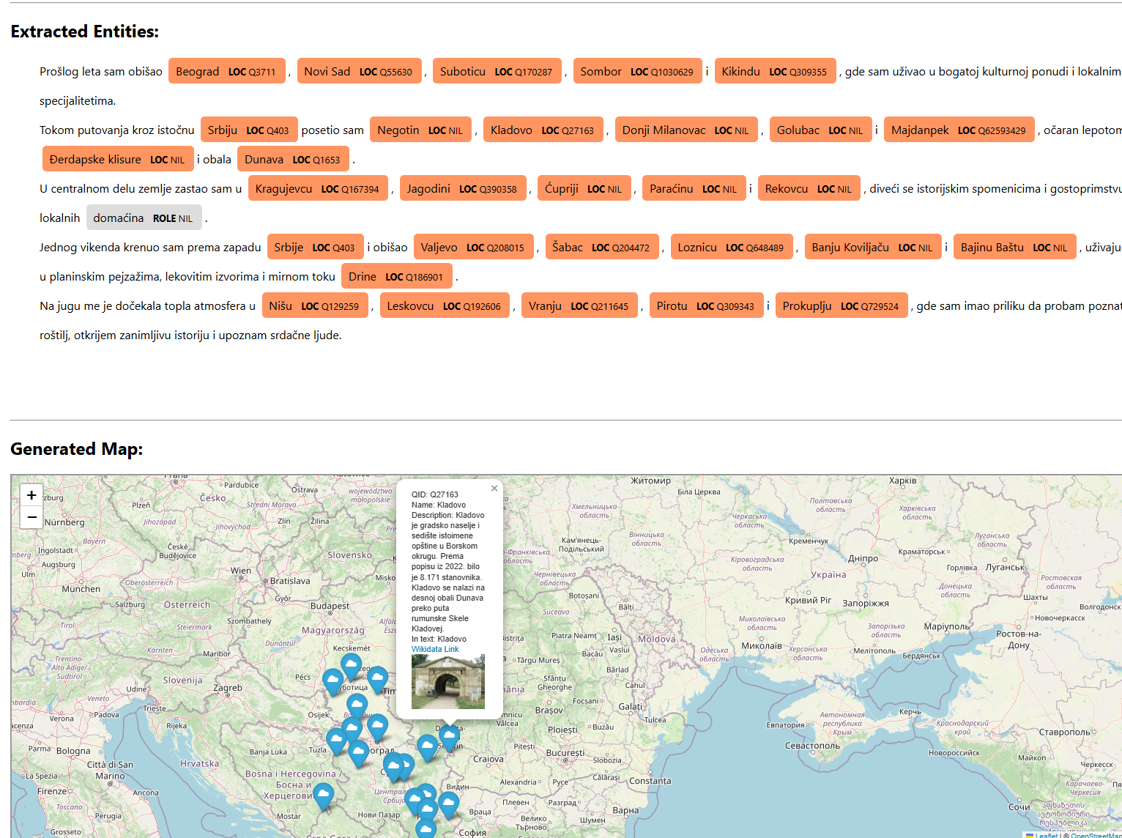
Entity Mapping Application (for text in Serbian)
https://w.wiki/CqWJ
Prošlog leta sam obišao Beograd, Novi Sad, Suboticu, Sombor i Kikindu, gde sam uživao u bogatoj kulturnoj ponudi i lokalnim specijalitetima.
Tokom putovanja kroz istočnu Srbiju posetio sam Negotin, Kladovo, Donji Milanovac, Golubac i Majdanpek, očaran lepotom Đerdapske klisure i obala Dunava.
U centralnom delu zemlje zastao sam u Kragujevcu, Jagodini, Ćupriji, Paraćinu i Rekovcu, diveći se istorijskim spomenicima i gostoprimstvu lokalnih domaćina.
Jednog vikenda krenuo sam prema zapadu Srbije i obišao Valjevo, Šabac, Loznicu, Banju Koviljaču i Bajinu Baštu, uživajući u planinskim pejzažima, lekovitim izvorima i mirnom toku Drine.
Na jugu me je dočekala topla atmosfera u Nišu, Leskovcu, Vranju, Pirotu i Prokuplju, gde sam imao priliku da probam poznati roštilj, otkrijem zanimljivu istoriju i upoznam srdačne ljude.
https://moth-distinct-locally.ngrok-free.app/

Slide 27
Approach: Pre-Process (NLP) Outside QGIS, Then Import
NLP Processing in Python
Use Python scripts/notebooks with spaCy, geopy, geograpy3, or others to:
Identify location mentions (Named Entity Recognition).
Geocode to lat/lon.
Create a table/CSV/GeoJSON with coordinates and attributes.
Load the Result into QGIS
QGIS can easily import GeoJSON, CSV (with lat/lon), or Shapefiles.
You then have a spatial layer of points (or polygons) derived from text, ready for visualization or further analysis in QGIS.
Advantages
Keeps QGIS simpler, since you’re not installing extra NLP libraries inside QGIS.
Easy to scale or run your NLP pipeline on servers/cloud, then just give results to QGIS.
→ Second approach: from QGIS using PyQGIS (not part of this presentation)

Slide 28
Practical part
Github:
https://github.com/rankastankovic/NLP4GIS
Colab Notebooks (make a copy):
https://colab.research.google.com/drive/11jn5YgJgPnxpApJN0FJTztbDYVD1yKTd?usp=sharing
https://colab.research.google.com/drive/1Q6xtCZ4TWsmh5qGVYYgReb82wZfwEx-M?usp=sharing

Slide 29
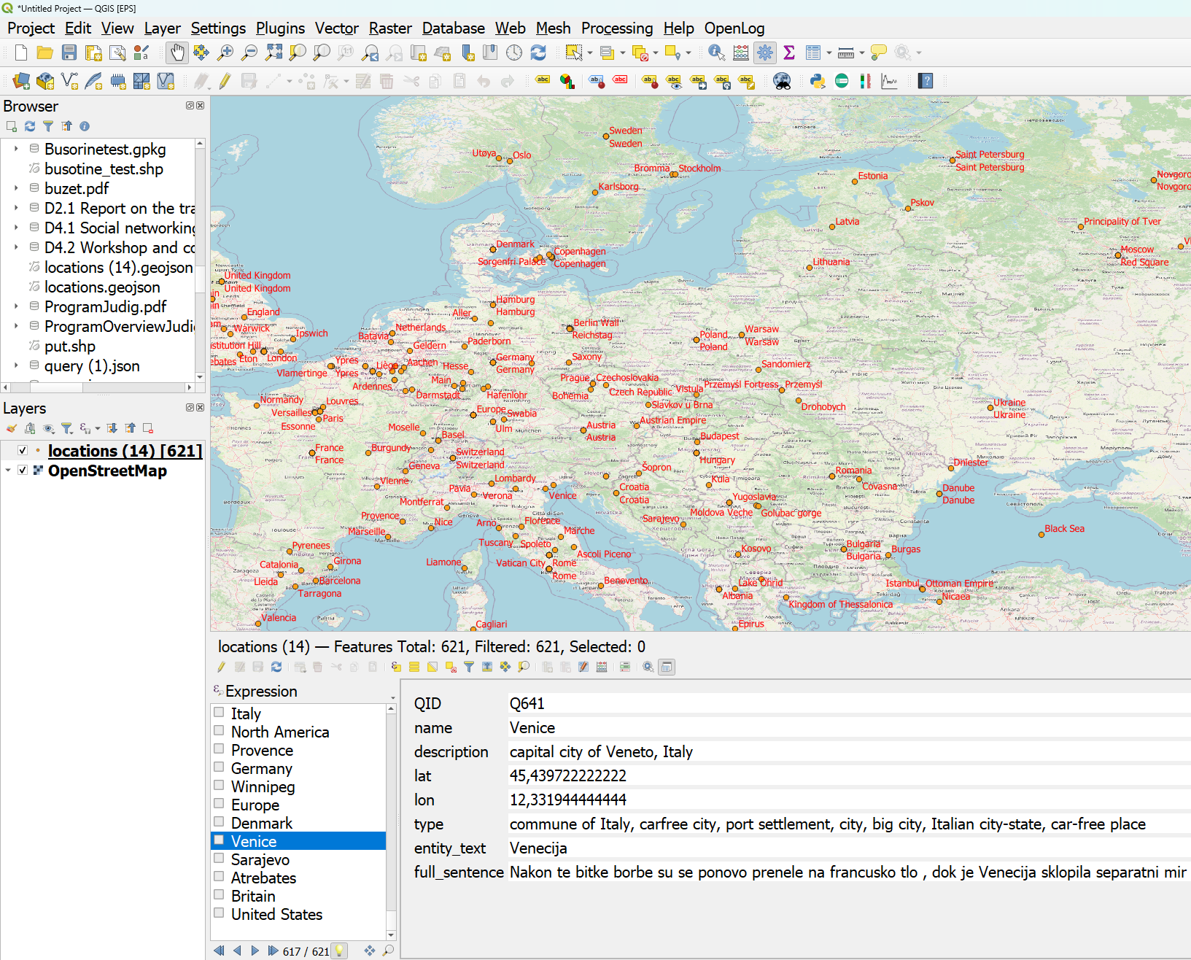
QGIS: NER+NER as geoJSON (more in practical part)

Slide 30




Text Embeddings - Serbian Language Applications, PRIZMA #7276
All presented models for Serbian are developed within project TESLA in cooperation with JeRTeh (Language Resources and Technologies Society)
Large collections of textual data (including annotated corpora)
A set of trained language models (pre-trained and fine-tuned)
Tools for the Serbian language: named entity recognition and linking to knowledge bases
A research conducted with the support of the Science Fund of the Republic of Serbia, project number: #7276
Text Embeddings - Serbian Language Applications – TESLA
https://tesla.rgf.bg.ac.rs/
https://jerteh.rs/

